Slide 1
Content Providers

Slide 2
Contents
What is a Content Provider
App with Content Provider Architecture
Implementation
Contract
Content Provider
Manifest Permissions
Content Resolver

Slide 3
What is a Content Provider?
A content provider is a component fetches data that the app requests from a repository
The app doesn't need to know where or how the data is stored, formatted, or accessed

Slide 4
What is a Content Resolver?
A content resolver is a component that your app uses to send requests to a content provider
Requests consist of a content URI and an SQL-like query
The Content Resolver object provides query(), insert(), update(), and delete() methods

Slide 5
How do they work together?
Activity/Adapter uses Content Resolver to query Content Provider
Content Provider gets data
Content Resolver returns data as Cursor
Activity/Adapter uses data
Activity / Adapter
ContentResolver
ContentProvider
Data

Slide 6
What is it good for?
Securely make data available to other apps
Manage access permissions to app data
Store data or develop backend independently from UI
Standardized way of accessing data
Required to work with CursorLoaders

Slide 7
Many apps can use one content provider
App that sells red hats
App that manages hat inventory
Content Resolver "Get red hats"
Content Resolver
Hat Store Content Provider
App that sells fancy hats
Content Resolver "Get fancy hats"
Hat inventory data

Slide 8
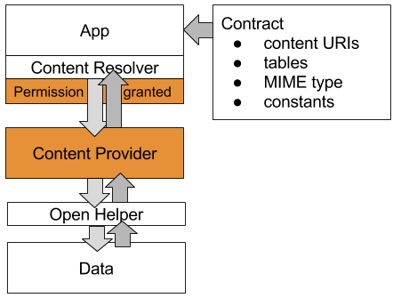
Components of a Content Provider App

Slide 9
Data Repository
Data, commonly in SQLite Database but can be any backend
OpenHelper if you use SQLite database

Slide 10
Contract
Public class that exposes information about the content provider to other apps
Contract specifies
URIs to query data
Table structure of data
MIME type of returned data
Constants

Slide 11
Content Provider
Public secure interface
Permissions control access
Subclass of Content Provider
query(), insert(), delete(), update() API

Slide 12
Content Resolver
Send requests to content provider and return response

Slide 13
Implementing a Content Provider
Data—Commonly an SQLite database
Write contract—Information about the content provider
Subclass Content Provider and implement methods
Get data using Content Resolver
Set permissions in Android Manifest

Slide 14
What's in a Contract?
Public class that documents content provider API
Called Contract by convention
Contains:
Content URIs and URI scheme to query data
Table and column names for returned data
MIME types to help process returned data
Shared constants to make life easier

Slide 15
Content URI
http:// and file:// are URIs for web pages and files
Content URI is path to data and uses content://
For example: request all the entries in the "words" table
content://com.android.example.wordcontentprovider.provider/words

Slide 16
General form of a URI
scheme://authority/path/id
scheme is always content:// for content URIs
authority represents the domain, and for content providers customarily ends in .provider
path is the path to the data
id uniquely identifies the data set to search

Slide 17
URI Scheme
By convention, provide constants for
AUTHORITY—Domain
CONTENT_PATH—Path to the data
CONTENT_URI—URI to one set of data

Slide 18
URI Scheme in Code
public static final String AUTHORITY = "com.android.example.minimalistcontentprovider.provider";
public static final String CONTENT_PATH =
public static | final | Uri CONTENT_URI = Uri.parse("content://"
+ AUTHORITY + | "/" + | CONTENT_PATH);

Slide 19
Table definitions
public static final String DATABASE_NAME = "wordlist";
public static abstract class WordList implements BaseColumns
{
public static final String WORD_LIST_TABLE = "word_entries";
// Column names...
public static final | String | KEY_ID = "_id";
public static final | String | KEY_WORD = "word";
}

Slide 20
MIME Type
Format of returned data
text/html for web pages, application/json for JSON data
App calls getType() to get MIME type from provider
Use Android's vendor-specific format for your content providers MIME type

Slide 21
Android's vendor-specific MIME Type
type.subtype/provider-specific-part
Type: vnd
Subtype
If URI pattern is for a single row: android.cursor.item/
If URI pattern is for more than one row: android.cursor.dir/
Provider-specific part: vnd.<name>.<type>
<name>: globally unique, such as company or package name
<type> unique to corresponding URI pattern, such as table name

Slide 22
MIME Type Example
Multiple words
vnd.android.cursor.dir/vnd.com.example.provider.words
One word
vnd.android.cursor.item/vnd.com.example.provider.words

Slide 23
MIME Type code in Contract
static final String SINGLE_RECORD_MIME_TYPE =
"vnd.android.cursor.item/vnd.com.example.provider.words";
static final String MULTIPLE_RECORDS_MIME_TYPE = "vnd.android.cursor.item/vnd.com.example.provider.words";

Slide 24
getType()
@Override
public String getType(Uri uri) { switch (sUriMatcher.match(uri)) {
case URI_ALL_ITEMS_CODE:
return MULTIPLE_RECORDS_MIME_TYPE;
case URI_ONE_ITEM_CODE:
return SINGLE_RECORD_MIME_TYPE; default:
return null;
}
}

Slide 25
Constants
Constants that are used by multiple classes in an app
Convenience constants for client use
Encapsulate parameters whose values might change as constants, so that if the content provider changes, the clients don't break

Slide 26
Content Provider
Extend Content Provider
public class WordListContentProvider
extends ContentProvider
{}

Slide 27
Content Provider Implement methods
query(), insert(), delete(), and update() methods
interact with the data backend …
… such as an Open Helper

Slide 28
Example insert()
/**
Inserts one record.
*
@return URI for the newly created entry.
*/ @Override
public Uri insert(Uri uri, ContentValues values) { long id = mDB.insert(values);
return Uri.parse(CONTENT_URI + "/" + id);
}

Slide 29
Manifest Permissions: Set Permissions
By default, with no permissions set explicitly, any other app can access a content provider for reading and writing
Set read or write permissions in AndroidManifest
Use unique tags that include package name

Slide 30
Provider in Android Manifest
<provider android:name=".WordListContentProvider" android:authorities=
"com.android.example.wordlistsqlwithcontentprovider.provider" android:exported="true" />

Slide 31
Permissions inside <provider>
android:readPermission=
"com.android.example.wordlistsqlwithcontentprovider.PERMISSION"
android:writePermission= "com.android.example.wordlistsqlwithcontentprovider.PERMISSION"

Slide 32
Client permissions
Granted by the user
<uses-permission android:name = "com.android.example.wordlistsqlwithcontentprovider.PERMISSION"/>

Slide 33
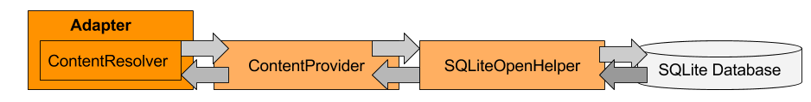
Content Resolver
Must use a Content Resolver to send requests as queries to the content provider
Data is returned in a Cursor object, as rows and columns

Slide 34
Content Resolver methods
ContentResolver.query()
ContentResolver.insert()
ContentResolver.delete()
ContentResolver.update()

Slide 35
getContentResolver.query()
public Cursor query( Uri uri,
String[] projection, String selection,
String[] selectionArgs,
String sortOrder){ … // implementation }

Slide 36
Calling getContentResolver.query()
Cursor cursor = getContentResolver().query( Uri.parse(queryUri), projection, selectionClause, selectionArgs, sortOrder);

Slide 37
Query parameter summary
uri: String queryUri = Contract.CONTENT_URI.toString();
projection: String[] projection =
new String[] {Contract.CONTENT_PATH};
selection: String where = KEY_WORD + " LIKE ?";
selectionArgs: String[]whereArgs = new String[]
{searchString};
sortOrder: > null for default, ASC / DESC

Slide 38
Summary of implementing content provider
Data, for example, in a database
A way for accessing the backend, for example, through an open helper Declare content provider in Android Manifest and set permissions
Extend Content Provider and implement query(), insert(), delete(), update(), count(), and getType() methods
Create public Contract class to expose URI scheme, table names, MIME type, and important constants to other classes and apps
Use a Content Resolver to send requests to content provider
Process data returned as cursor

Slide 39
Classwork
Implement Content Provider for the database “goods.db” (slot 16)
Create the second app to get data from “goods.db”

Slide 40
References
https://google-developer-training.github.io/android-developer-fundamentals-course-concepts-v2/

